Slide 1
Analysis and Forecasting of COVID-19 New Cases in South America
Time Series and Forecast Project

Slide 2
Table of contents
01
02
03
04
05
06
Data Preparation
Data Visualization
Model Specification
Model Estimation
Performance Evaluation
Forecast Production

Slide 3
01
Data Preparation

Slide 4
The data preparation steps
Handling Missing Values
Summarizing Data
Using "summarise" and "sum" functions to calculate total new cases.
Preparing for Time Series Analysis: Converting "date" to a date format and transforming datasets into tsibble objects.
Using "is.na" to check and "na.omit" to remove missing values, ensuring data completeness.
Splitting Dataset
Selecting & Grouping Columns
Two datasets - "Data" for continent level and "Datawithlocation" for location-specific information.
Choosing relevant columns like "continent," "new_cases," and "date," and grouping them for analysis.

Slide 5
The data preparation steps
Tsibble Transformation
Frequency Consideration
Data Conversion for Time Series Analysis
Transform both datasets into tsibble objects, setting "continent" as the key for "Data" and both "continent" and "location" for "Datawithlocation."
Choose to convert the data to a daily frequency rather than a monthly one. This decision is made to capture more detailed insights, as a monthly aggregation would result in a significantly reduced dataset.
Convert the "date" column from character to date format using the "as_date" function. This is essential for effective time series analysis.

Slide 6
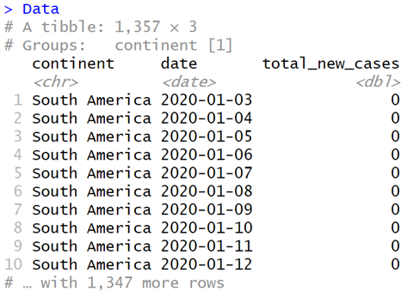
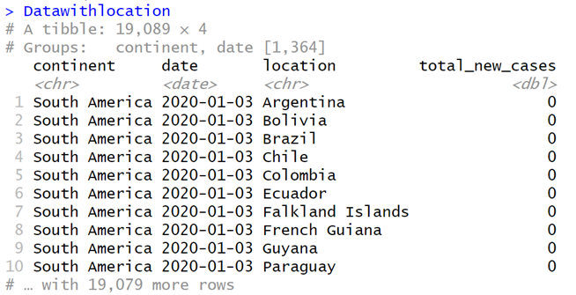
The data preparation steps
Data tibble - First 10 rows after preprocessing.
Datawithlocation tibble - First 10 rows after preprocessing with location.

Slide 7
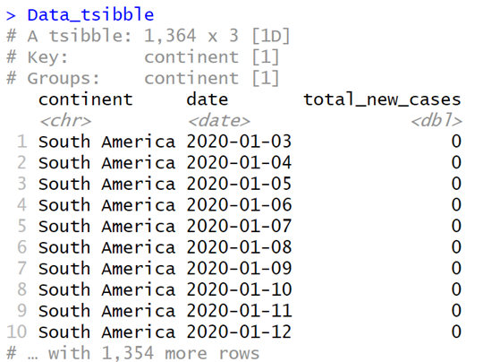
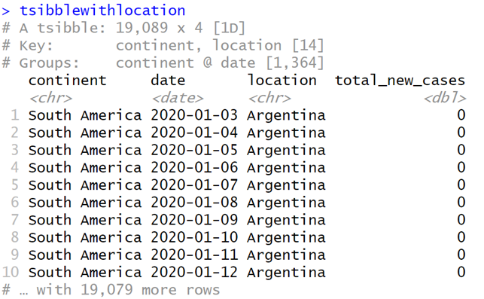
The data preparation steps
Data_tsibble tsibble - First 10 rows after preprocessing.
tsibblewithlocation tsibble - First 10 rows after preprocessing with location.

Slide 8
02
Data Visualization

Slide 9
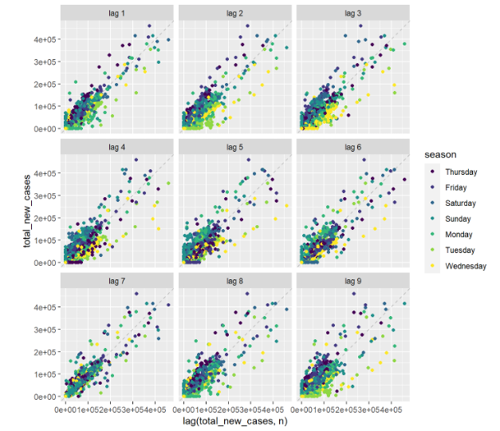
Lag Plot
Strong positive correlations between seasons, indicating strong seasonality.

Slide 10
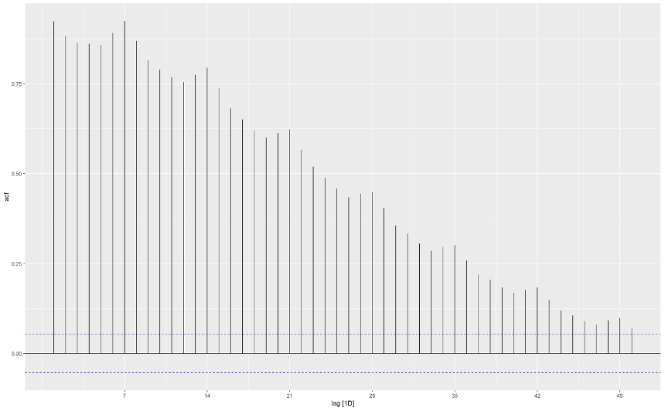
ACF
Correlations are significant, indicating that data is not white noise

Slide 11
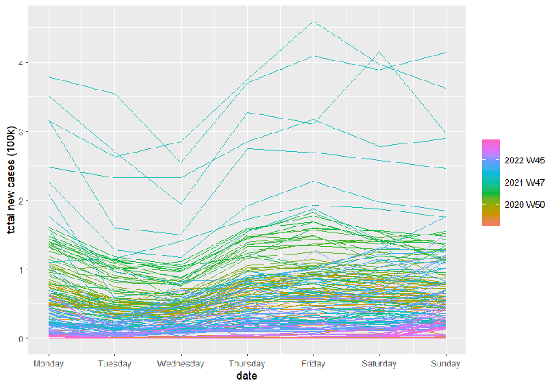
Seasonality, Trend, and Cyclic
Friday has the highest number of new cases
Weeks in the year 2022 have the highest number of new cases
Notes:
seven weeks in the year 2022 have the highest number of new cases

Slide 12
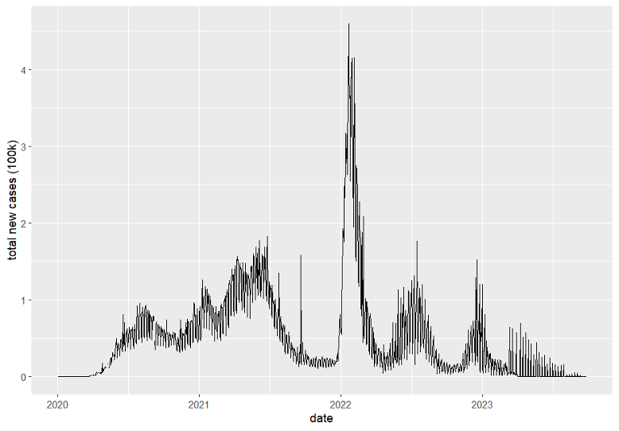
Time Plot
Increasing trend from mid-2020 until mid-2021
Spike in the beginning of 2022
New cases goes up on mid-2022, and on the beginning of 2023
Notes:
new cases goes up on mid-2022 and on the beginning of 2023.

Slide 13
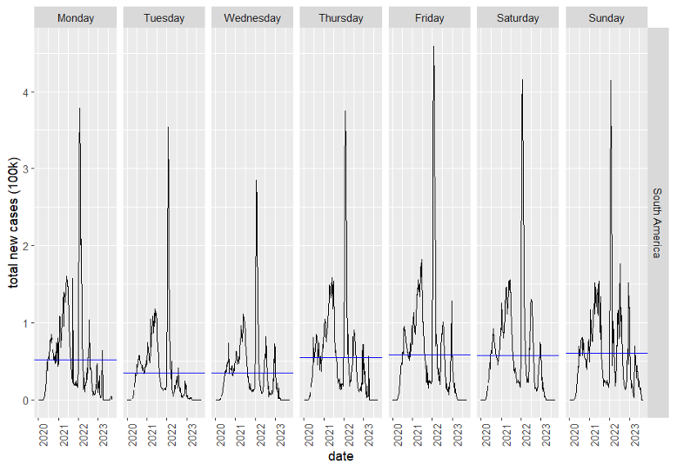
Subseries
2022 has the highest number of new cases
Average number of new cases for each day is similar

Slide 14
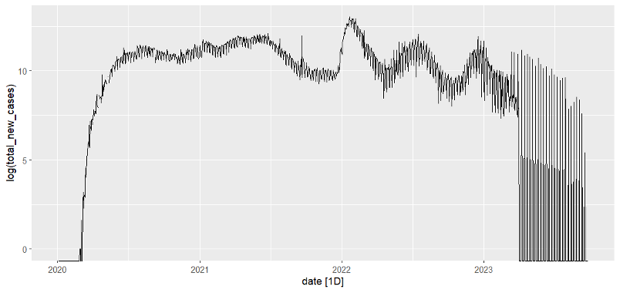
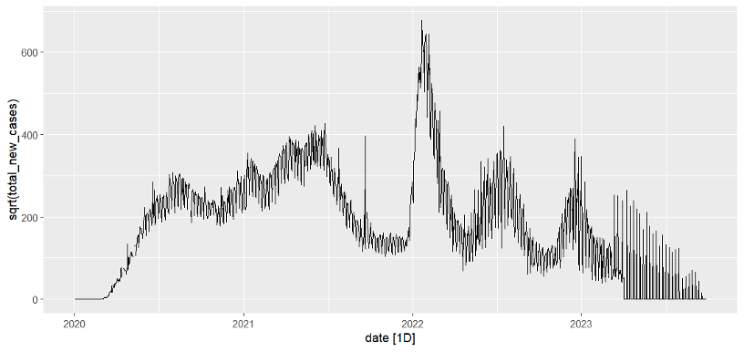
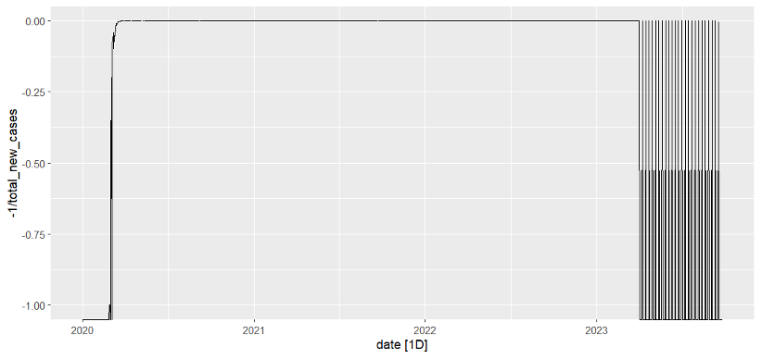
Mathematical Transformation
Log
Square Root
Inverse
Linearize trends, making them more apparent in plots.
Stabilize variance and highlight cyclic behaviours
Reverse effects and interpret data in its original scale
Notes:
Log: not good for our data, square: better, inverse: not good

Slide 15
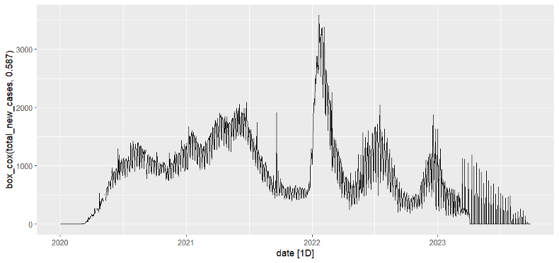
Mathematical Transformation
Guerrero method: balances the seasonal fluctuation and random variation
Notes:
best value of lambda which is 0.587 found using “Guerrero” method, this balances the seasonal fluctuation and random variation.

Slide 16
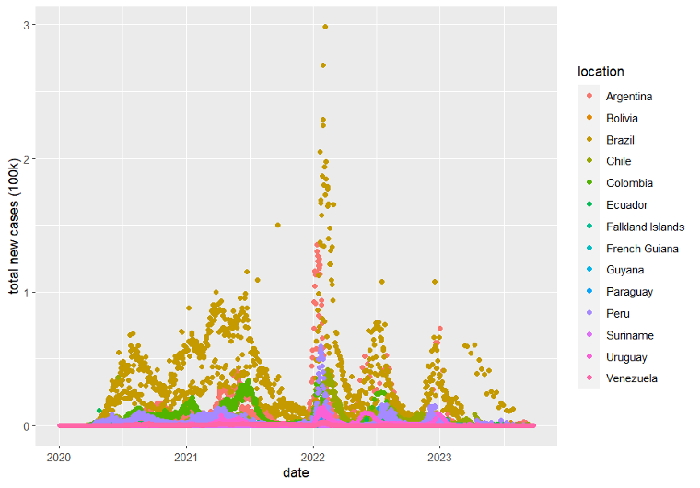
Plots with Locations
Point Plot
Brazil has the highest number of new cases across the years
Suriname, Uruguay, and Venezuela have the lowest number of new cases
Notes:
Suriname, Uruguay, and Venezuela have the lowest number of new cases

Slide 17
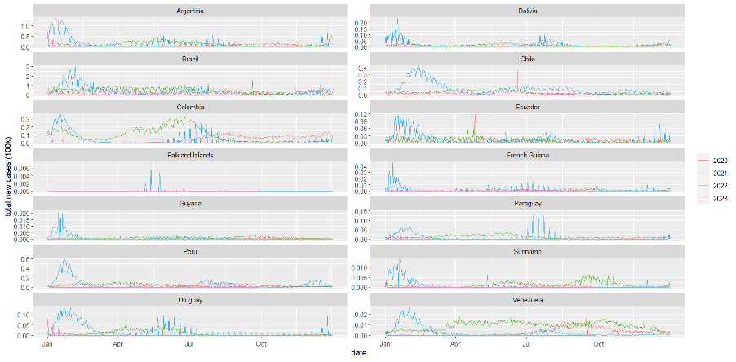
Plots with Locations
Season Plot
Falklands Islands has new cases on 2022 only on May and July
Guyana has new cases at the beginning of 2022
Notes:
we can see that for the country Falkland Islands has new cases on 2022 only and it is in May and July, and for Guyana there was new cases at the beginning of 2022. And like the previous plots Brazil has the highest number of cases. And for the rest of the countries, it varies from year to year.

Slide 18
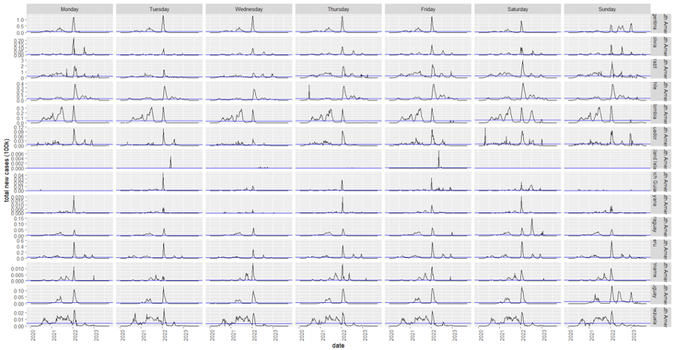
Plots with Locations
Subseries Plot
Falklands Islands has least number of new cases
Brazil has highest number of new cases
Most countries have high number of new cases in 2022
Notes:
Falkland Islands shows the least number of new cases, and Brazil the highest number of new cases. Most countries have higher number of new cases in 2022.

Slide 19
03
Model Specification

Slide 20
Naive Model
The "Naive Method" is one of the simplest and most straightforward time series forecasting techniques.
The Naive Method can serve as a straightforward benchmark and provide a quick reference point for assessing the performance of more complex models.
While it does not consider seasonality, trends, or external factors, it can be useful in situations where the data is relatively stable over time or when you need a basic, rapid forecast to gain a preliminary understanding of future trends.
1

Slide 21
Seasonal Naive (Snaive) Model
The Seasonal Naive (Snaive) Model forecasts future values by simply using the most recent observation from the same season.
The model is chosen based on the robust seasonal patterns evident in the data, reflected in the significant positive correlation between seasons.
This choice is particularly suitable for the COVID-19 dataset, which exhibits pronounced seasonality.
2

Slide 22
Regression model
Regression models analyze relationships between dependent and independent variables.
The model can effectively forecast COVID-19 dynamics by incorporating these features:
Positive correlations in daily cases
Autocorrelation functions confirm temporal dependencies
Weekly and yearly plots show distinct patterns.
3

Slide 23
TSLM (Time Series Linear Model)
Linear regression for time-series analysis, capturing underlying linear relationships in sequential data.
Extends simple linear regression to time series
Suitable for identified seasonality patterns
Flexible with seasonality, trends
4

Slide 24
04
Model Estimation

Slide 25
Data Splitting
The first step in our forecasting process was to split the data into training and test sets.
This division ensured that 80% of the data was allocated to the training set, while the remaining 20% was reserved for testing the model's performance.

Slide 26
Model Training
We then proceeded to train four different models:
Naive Model: This model, trained using the NAIVE function, assumed that the future value of the total new cases of COVID-19 is equal to the most recent observed value.
Seasonal Naive Model: The SNAIVE function was used to train this model, which takes into account the seasonality of the data. It predicts future values based on the corresponding values from the same season in previous years.

Slide 27
Model Training
We then proceeded to train four different models:
Regression Model: In this model, we employed a regression model with a constant term (total_new_cases ~ 1). This model captured both the trend and seasonality of the data.
Time Series Linear Model (TSLM): The TSLM function was utilized to train this model, which considered the linear relationship between the total new cases of COVID-19 and time. It could capture trend, seasonality, and other time-dependent patterns.

Slide 28
Generating Forecasts:
After training the models, we generated forecasts using the test data for evaluation purposes.
These forecasts were stored in separate variables (naive_forecast, snaive_forecast, regression_forecast, tslm_forecast) for further analysis and comparison.
This comprehensive approach allowed us to assess the performance of multiple forecasting models and select the most suitable one for predicting future COVID-19 cases in South America

Slide 29
05
Performance Evaluation

Slide 30
Table of Models’ Performance.
ML Algorithms | Models’ Performance
 | ME | RMSE | MAE | ACF1
Naive model | -61193 | 63257 | 61651 | 0.325
Snaive model | -49288 | 60385 | 50358 | 0.0867
Regression model | -61638 | 73228 | 62660 | 0.149
TSLM model | -53222 | 55583 | 53887 | 0.325

Slide 31
06
Forecast Production

Slide 32
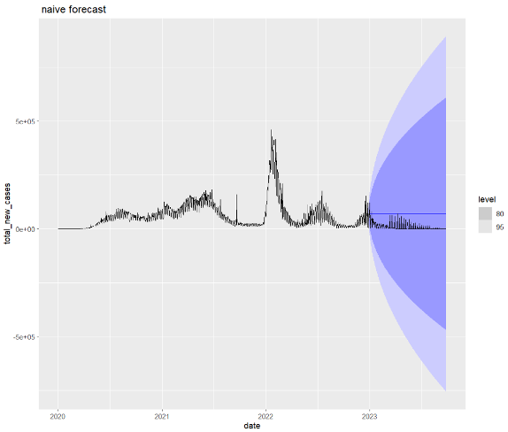
Naive Forecast
Model overestimate the actual values
Mode exaggerates the expected rate of increase

Slide 33
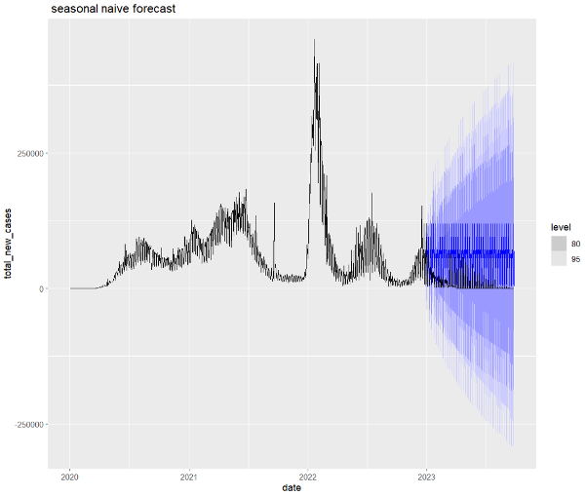
Seasonal Naive Forecast
Captures a recurring pattern and provides a glimpse of the fluctuations in the data
Consistent overestimation

Slide 34
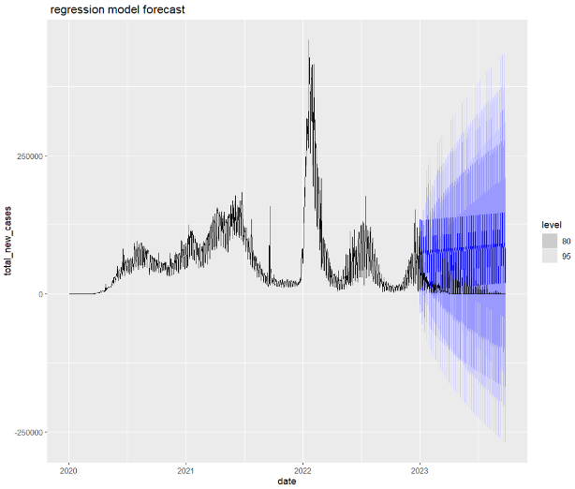
Regression Forecast
Model overestimates actual values
Worst performing model with the highest errors

Slide 35
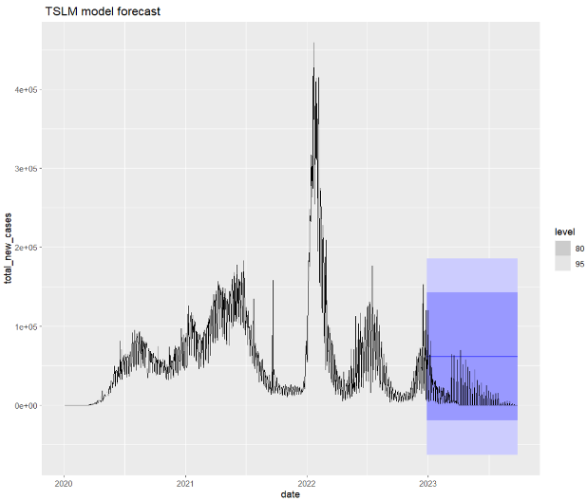
TSLM Forecast
Model overestimates actual values
Higher certainty and less variability
Best performing model

Slide 36
References
[1] TY - JOUR, AU - Cheng, Chieh, AU - Jiang, Wei-Ming, AU - Fan, Byron, AU - Cheng, Yu-Chieh, AU - Hsu, Ya-Ting, AU - Wu, Hsiao-Yu, AU - Chang, Hsiao-Han and AU - Tsou, Hsiao-Hui, " Real-time forecasting of COVID-19 spread according to protective behavior and vaccination: autoregressive integrated moving average models," BMC Public Health, 2023.
[2] "Tibbles," rstudio, [Online]. Available: https://cran.r-project.org/web/packages/tibble/vignettes/tibble.html. [Accessed 25 10 2023].
[3] M. Almobarak, S. Aljuhani, N. Alotaibi and S. Altaweel, github, [Online]. Available: https://github.com/monerahalmobarak/Faculty-Data-Analysis. [Accessed 25 10 2023].
[4] E. Wang, "Introduction to tsibble," rstudio, [Online]. Available: https://cran.rstudio.com/web/packages/tsibble/vignettes/intro-tsibble.html#:~:text=Built%20on%20top%20of%20the,makes%20heterogeneous%20data%20structures%20possible.. [Accessed 25 10 2023].
[5] "R: Lag plots," 25 10 2023. [Online]. Available: https://search.r-project.org/CRAN/refmans/feasts/html/gg_lag.html.
[6] "acf function - RDocumentation," [Online]. Available: https://www.rdocumentation.org/packages/stats/versions/3.6.2/topics/acf.
[7] [Online].
[8] "Seasonal subseries plots — gg_subseries," [Online]. Available: https://feasts.tidyverts.org/reference/gg_subseries.html.
[9] D. Curran-Everett, "Explorations in statistics: the log transformation," p. 5, 2018.
[10] D. Neufeld, "Visualization Methods for Periodic Time Series Data," p. 10, 2021.
[11] R. J. Hyndman and G. Athanasopoulos, Forecasting : Principles and Practice, vol. 2, Heathmont, Vic.: Otexts, 2018.
[12] "Pluralsight," [Online]. Available: https://www.pluralsight.com/guides/time-series-forecasting-using-r.
[13] "TimeSeries," [Online]. Available: https://github.com/mshanker1/60095_201810/blob/master/TimeSeries.Rmd.
[14] "rpubs," [Online]. Available: https://rpubs.com/Bassel2014/382416.
[15] R. J. Hyndman, "Accuracy measures for a forecast model," forecast, 2018. [Online]. Available: https://pkg.robjhyndman.com/forecast/reference/accuracy.default.html.
[16] "R: Forecast plot," [Online]. Available: https://search.r-project.org/CRAN/refmans/forecast/html/plot.forecast.html.

Slide 37
Thanks!
ID | Name
442002988 | Monerah Almobarak
442005420 | Alaa Alshuaibi
442000786 | Sarah Altaweel
442005104 | Sarah Aljuhani
442003374 | Nada Alotaibi

